Slide 1
Hidden page
Not for the students.
Notes below the pages may be helpful to the teachers.
Notes:
This page is not for the students but for the teaches.

Slide 2
Welcome
Notes:
Welcome slide.

Slide 3
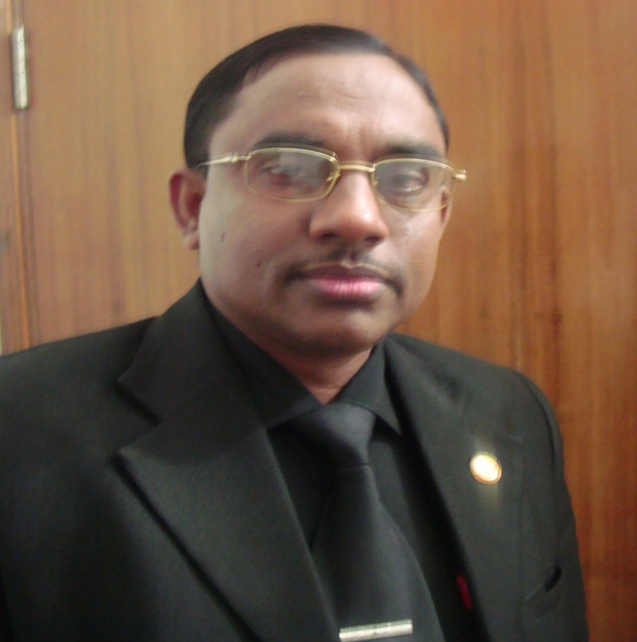
I am Md. Hasan Hafizur Rahman,
Senior Lecturer (English)
Cambrian School & College, Dhaka, going to conduct the class with you on Eng-1,Class-8.
Notes:
Introduction.

Slide 4
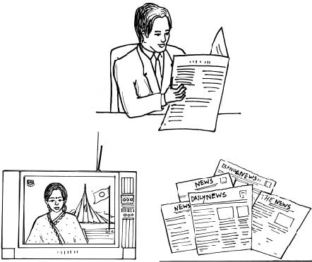
A Look at the following pictures. Discuss with your partner what you see in them.
Notes:
Teacher may give the students some times to discuss the pictures of 4 & 5 pages themselves.

Slide 5
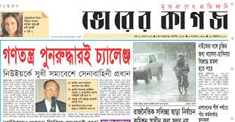
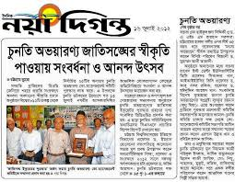
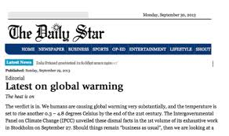
Notes:
To advance the students to news.

Slide 6
Our Today’s class is-
News! News! News!
Unit-8, Lesson-2
Notes:
Teacher may go to the page No. 16 directly by clicking the right arrow to avoid word meaning section.

Slide 7
Learning outcomes
At the end of this lesson, we will be able to---
ask and answer questions
read and understand text materials
participate in short dialogues and conversation
write answers to questions
Notes:
This slide is a hidden page.

Slide 8
Key words
Teacher may show the word first to ask meaning of the word. Then he can show and advance to the next.
Notes:
Hidden page.

Slide 9
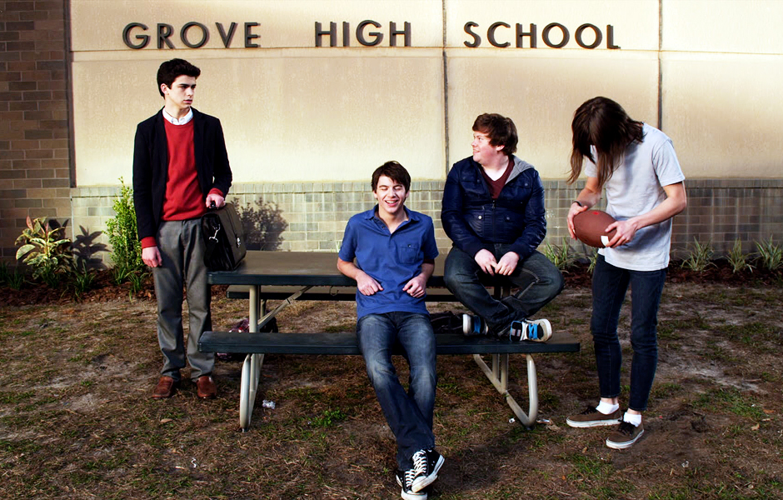
Bunk off
Meaning: truanting /staying out of school
I never bunk off school.
Notes:
Teacher may show the word first to ask meaning of the word. Then he can show and advance to the next.

Slide 10
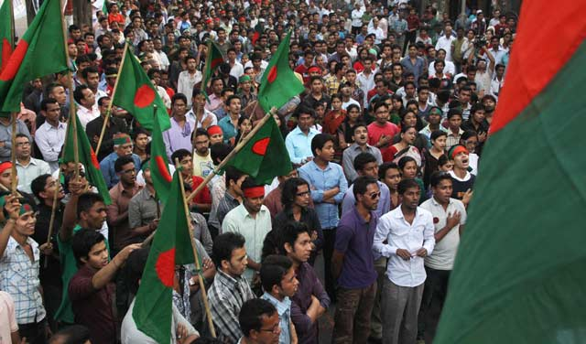
Mass people
Meaning: general public, citizens
Market is a place of mass people.
Notes:
Teacher may show the word first to ask meaning of the word. Then he can show and advance to the next.

Slide 11
Bias
Meaning: Prejudice, Partiality
It is not good to bias to the poor.
Notes:
Teacher may show the word first to ask meaning of the word. Then he can show and advance to the next.

Slide 12
Broadcast
Meaning: Transmission/ transfer to web
The elaboration if BBC is British Broad Casting Corporation
Notes:
Teacher may show the word first to ask meaning of the word. Then he can show and advance to the next.

Slide 13
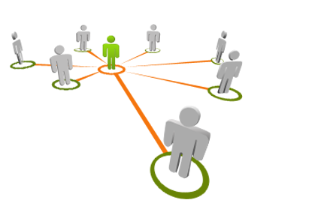
Refer
Meaning: reference, send
He referred it to me.
Notes:
Teacher may show the word first to ask meaning of the word. Then he can show and advance to the next.

Slide 14
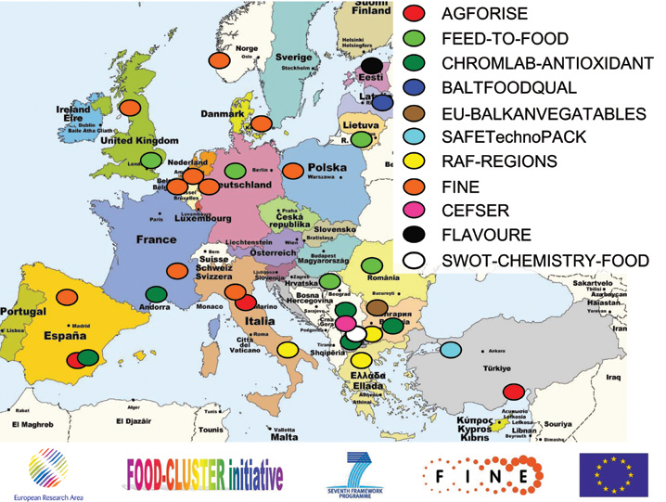
Informative
Meaning: Full of information
This picture is informative.
Notes:
Teacher may show the word first to ask meaning of the word. Then he can show and advance to the next.

Slide 15
Editorial
Meaning: Journalistic, magazine
I enjoy editorial option very much.
Notes:
Teacher may show the word first to ask meaning of the word. Then he can show and advance to the next.

Slide 16
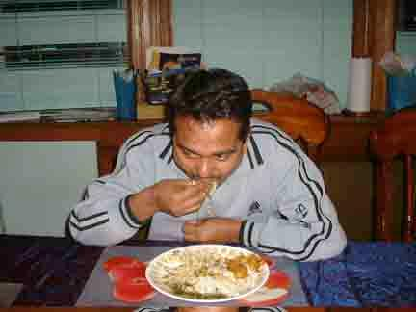
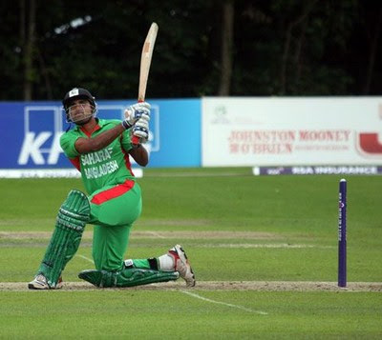
B Read the text and answer the following questions.
I eat rice every day.
I play cricket.
Notes:
Teacher may ask the students to read this option.

Slide 17
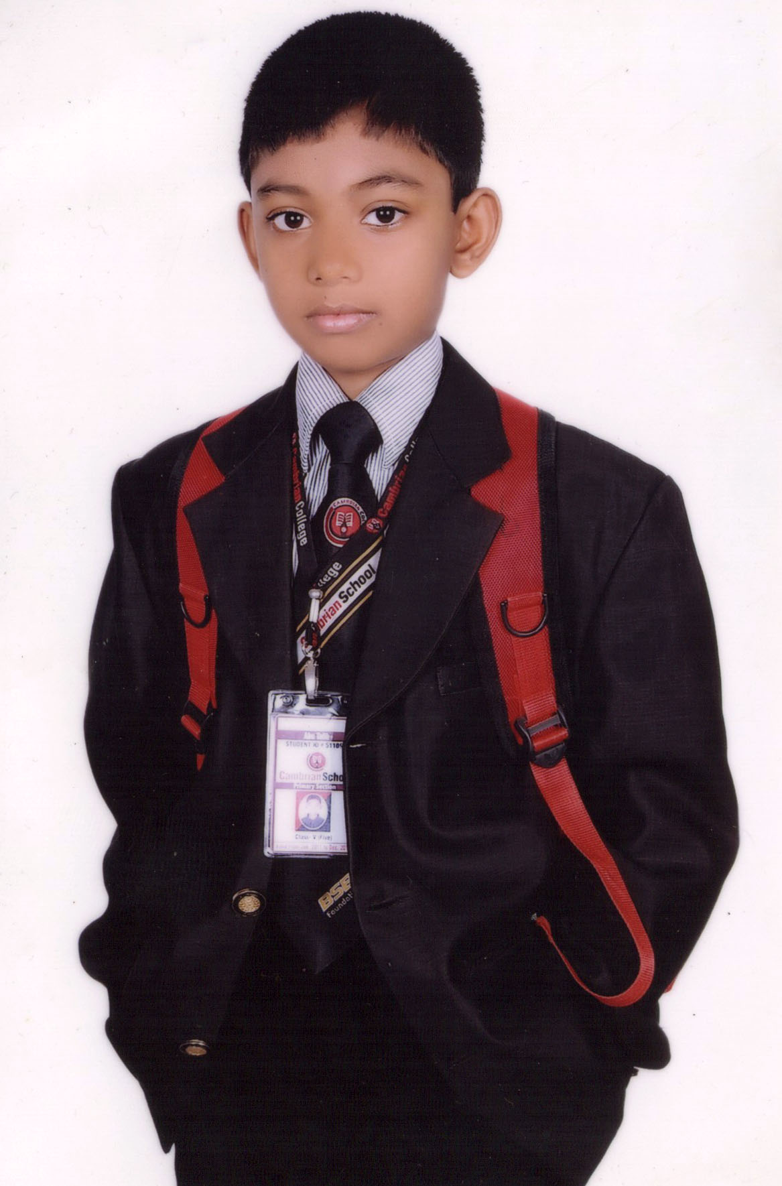
I don’t bunk off school, blah…blah…blah…
These are common events. They happen every day or on some occasions.
Notes:
Students may read this option.

Slide 18
Are these events -?
Should they be published in -?
Notes:
Teacher may conduct this page.

Slide 19
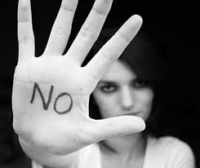
The answer is a big
Then what is news anyway?
What do we want to know from the media?
Notes:
Teacher may use intonation here.

Slide 20
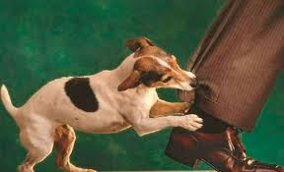
'When a dog bites a man that is not news,
Notes:
It is a normal event.

Slide 21
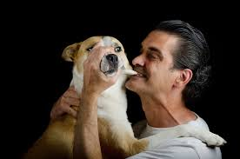
but when a man bites a dog that is news.' says Charles Anderson Dana.
Notes:
Teacher may explain.

Slide 22
The first thing is that the news should be a piece of-
Notes:
Text reference.

Slide 23
Secondly, the information should be recent or new,
and hence it is 'news'.
Notes:
From the text.

Slide 24
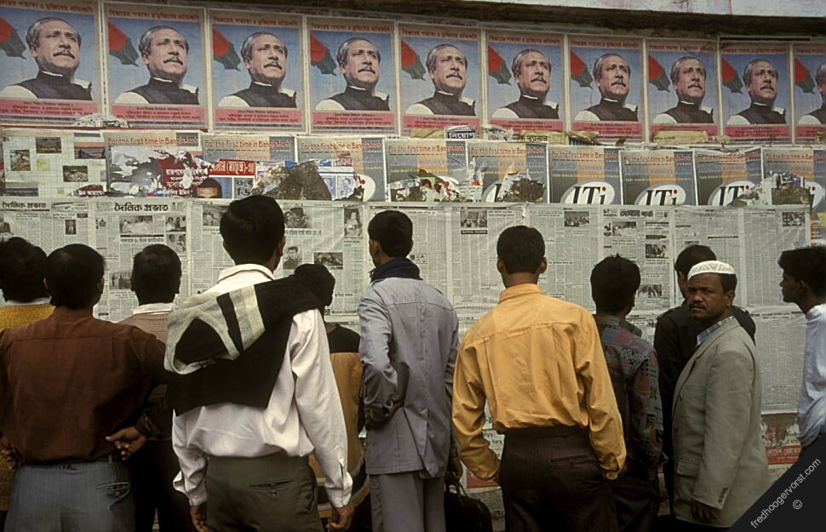
Thirdly, mass people should take interest in it.
Notes:
Teacher may ask the students to tell something about the picture.

Slide 25
Fourthly, it should be self-explained. That is, it should answer all the questions with who, which, what, where, when, why, and how.
Notes:
Teacher may read it loudly with proper sound, stress and intonation.

Slide 26
Printed news
broadcast
Internet.
Finally, it should be objective. Recently, another aspect has been added: news is either printed or broadcast or on the internet.
broadcast
Notes:
Teacher may place the meaning of the word ‘broadcast’ clicking on broadcast. Then he can go back to the page number 27 by clicking the right arrow of page No.12

Slide 27
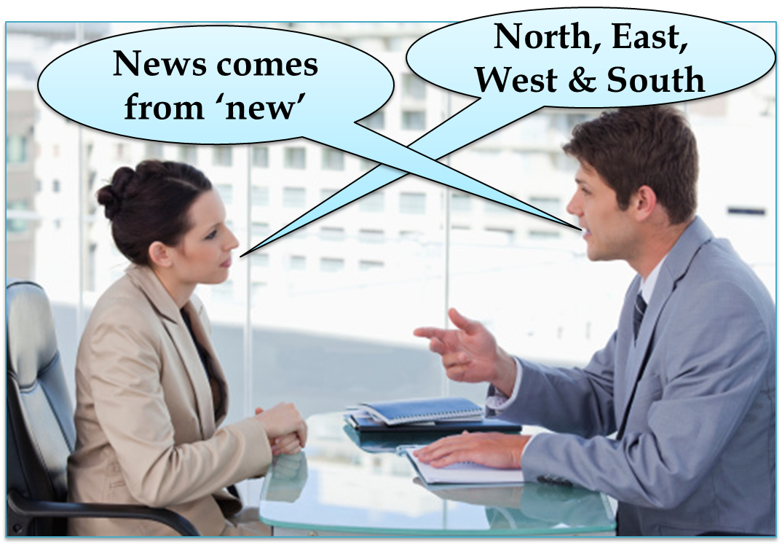
There are opinions that the term ‘news’ comes from ‘new’. Others say it is news because it comes from all directions: North, East, West and South.
Notes:
Teacher may explain this page.

Slide 28
Questions
1 What features should news have?
2 What is the difference between news and an event?
3 ‘……it should be self-explained...’. What does ‘it’ mean here?
4 What are the opinions about the term ‘news’?
5 What must be there in the information in a newspaper?
Notes:
Teacher may ask the students to write the answers of the questions.

Slide 29
Pair Work
C Find the following words/phrases in italics in the text in B. Discuss with your partner and try to guess their meaning from the context. Then match them with their meanings in the right column. First one is done for you.
Notes:
Teacher may ask the students to match the columns to write the sentences correctly .

Slide 30
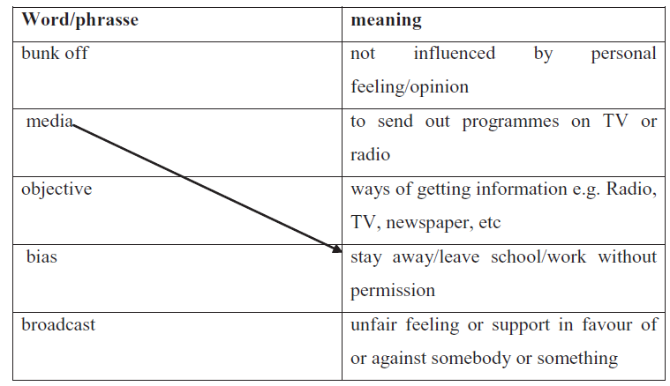
Notes:
Teacher may ask the students in pair to write a short dialogue on section D.

Slide 31
E Look at the following comment.
The advertisement is the most truthful part of a newspaper--- Thomas Jefferson.
Now make similar sentences from the substitution table
Notes:
Teacher may conduct this option orally and individually.

Slide 32
F Ask and answer with your partner.
1 Do you read any newspaper/magazine?
2 When do you usually read it?
3 Which newspaper/magazine do you read?
4 What makes it different from other newspapers / magazines?
5 Which news items do you like most ---- international affairs, sports, movie, culture, politics, etc?
6 Do you share your favourite news item/s with your friend/s?
G Write a paragraph on your habit of reading newspapers. You can take your cues from the questions in section F.
Notes:
Section F is for section G. Teacher may give section G as home work to the students .

Slide 33
Allah Hafez

Slide 34
Acknowledgement
We would like to express our cordial gratitude to the Ministry of Education, Directorate of Secondary & Higher Education, NCTB, A2i and the panel of honorable editors ( Md. Jahangir Hasan, Assistant Professor (English) TTC, Rangpur, Ranjit Poddar, Associate Professor (English) TTC, Dhaka, and Urmila Khaled, Assistant Professor (English) TTC, Dhaka, to enrich the contents.

